Slide 1


SocialBuzz

Slide 2


Today's agenda
Project recap
Problem
The Analytics team
Process
Insights
Summary

Slide 3

Social Buzz is a fast growing technology unicorn that need to adapt quickly to it’s global scale.
Accenture has begun a 3-month POC focusing on these tasks:
An audit of Social Buzz’s big data practice
Recommendations for a successful IPO
Analysis to find Social Buzz’s top 5 most popular categories of content
Project Recap

Slide 4

Problem
Over 1 000 000 posts per day
36 500 000 pieces of content per year!

Slide 5



The Analytics team

Slide 6
Data Understanding
Process
1
Clean Data
2
Data Modeling
3
Data Analysis
4
5
Uncover Insights

Slide 7

Insights
17 different categories
Most popular category has
53 935 reactions
The top content type is Video

Slide 8
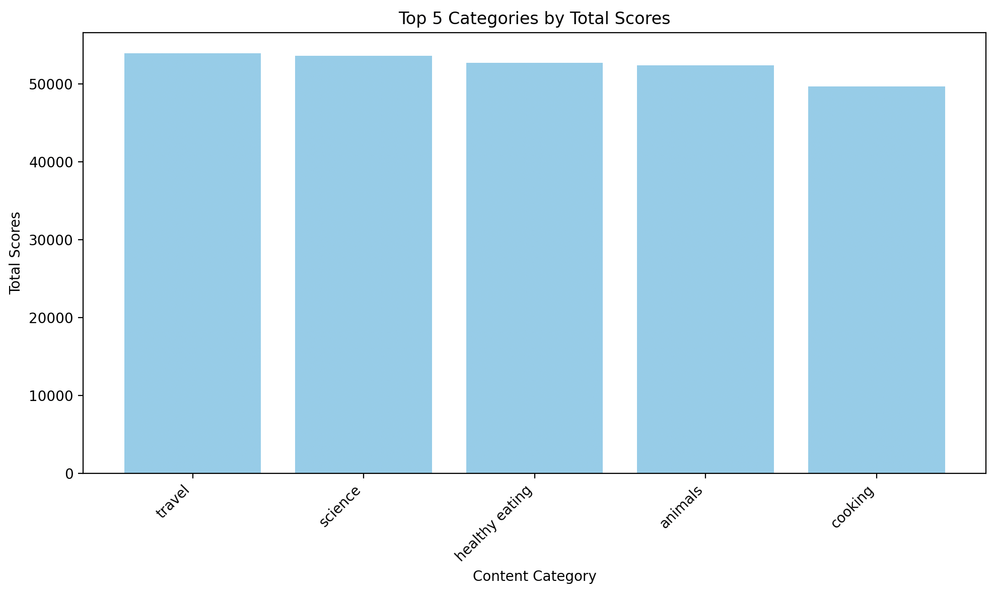
TOP 5:
TRAVEL – 20.5% SCIENCE – 20.4%
HEALTHY EATING – 20.1% ANIMALS – 20% COOKING – 18.9%

Slide 9
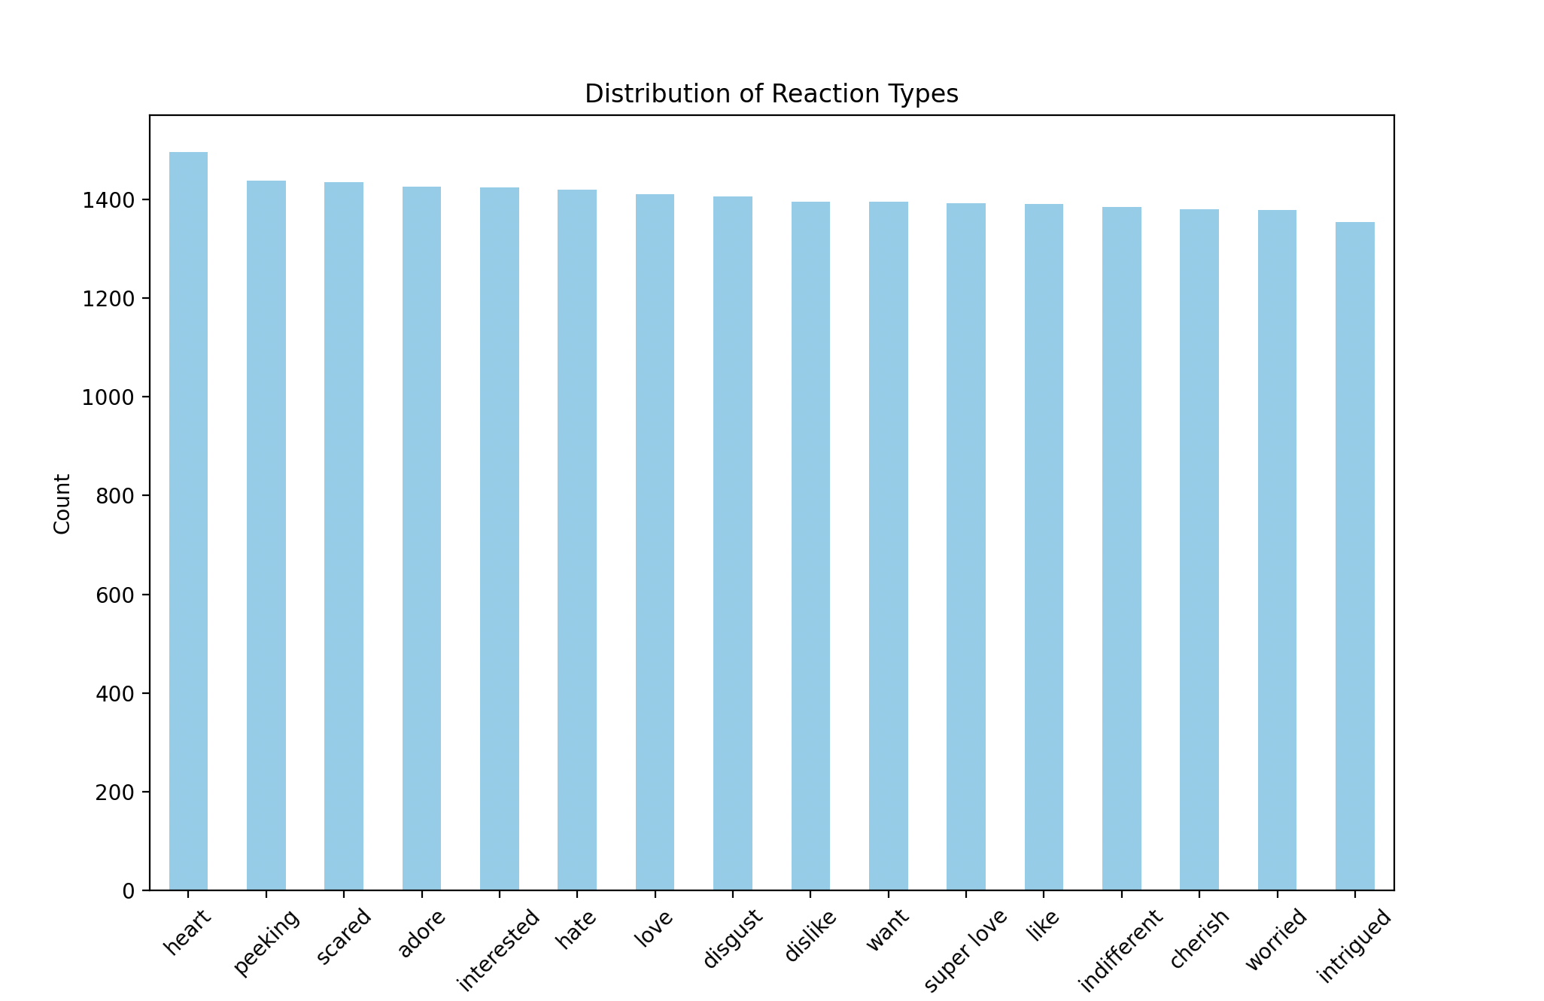

Slide 10

SocialBuzz top 5 content categories are: TRAVEL – 20.5% SCIENCE – 20.4% HEALTHY EATING – 20.1% ANIMALS – 20% COOKING – 18.9%
Top types of content are: video and audio
Top reaction is “heart”
Summary

Slide 11

Thank you!
ANY QUESTIONS?

